Slide 1
Excel Masters
Enter if you dare . . .
Which Cursor and
Function should I use?

Slide 2
How to play
The following is little pretest of Excel Cursors and functions we will learn in class.
Follow directions and click on the appropriate cursor, cell, etc.
Play until you get them all correct.
Bring it on!
(Click Here to Start)

Slide 3
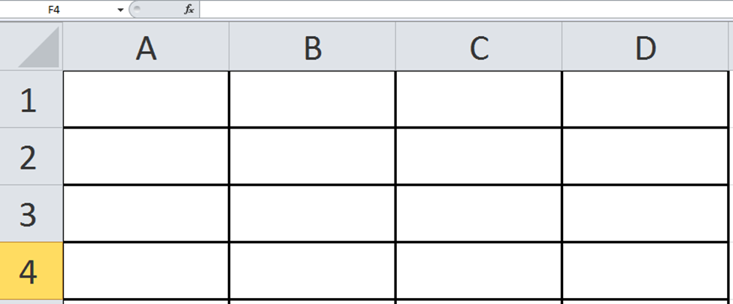
Which Cursor Would you use to Select the range A2:C3

Slide 4
“Excel”ent!!!
The white cross is your insert cursor and cursor to select multiple cells.
Go to the next Question

Slide 5
Oops, Try Again. If you use the wrong cursor, you will end up moving data or selecting the wrong cells. Go back and try again.
Go Back

Slide 6
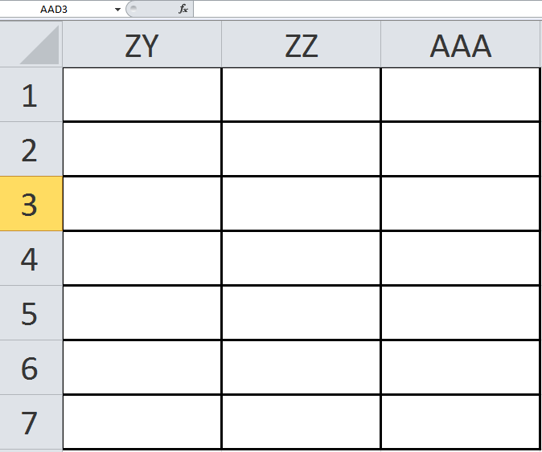
Which Cursor would you use to highlight Column ZZ?

Slide 7
Oops, Try Again. If you use the wrong cursor, you will end up moving data or selecting the wrong cells. Go back and try again.
Go Back

Slide 8
“Excel”ent!!!
The White Cross turns into a Black Down Arrow when you hover over the letter above the column.
Go to the next Question

Slide 9
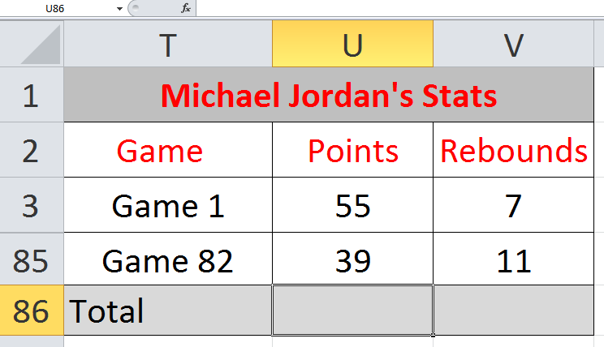
To insert a Total Function in U:86, where should you click in the cell?

Slide 10
“Excel”ent!!!
Always try to select the cell in the middle when performing a function or selecting a cell
Go to the next Question

Slide 11
Sorry, if you click there you could have major issues . . . Try again. You’ll get it.
Go Back

Slide 12
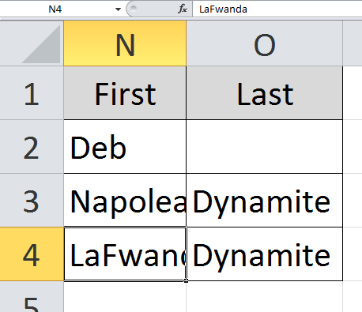
Which Cursor Would you use to increase the width of Column N?

Slide 13
This one’s kind of tricky. You can either click and drag to the desired length, or you can double click between the columns. The cursor will look the same for both.
Go Back

Slide 14
“Excel”ent!!!
Great Job! At this rate Uncle Rico will have to make you a Quesadilla.
Click here to go to the next question.

Slide 15
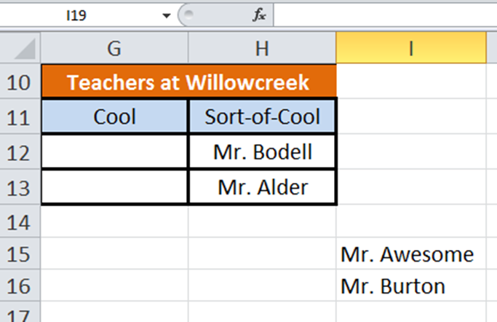
Which cursor would you use to move I15:I16 to G12:G13

Slide 16
“Excel”ent
Great Job! Keep it up! Always use this cursor to move a selected range
Glad to see you haven’t been monkeying around in class.
Click here to go to the next question.

Slide 17
Oops. You’re close. This cursor you’ll need to use at the top left corner of the selected range to move it to the new range.
Go Back

Slide 18
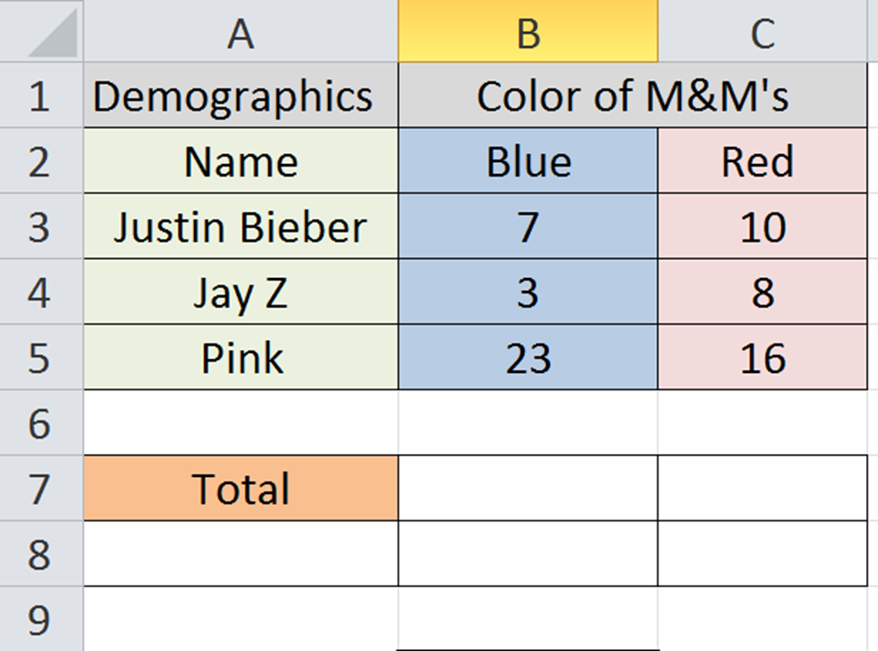
Which Function would you use to find the total of column B?
=SUM(B2:B5)
=(SUM)B2-B5
=SUMB2:B5
SUM(B2:B5)

Slide 19
Oops. Make sure you have the parenthesis in the correct spot or you’ll get an error message.
Go Back

Slide 20
“Excel”ent!!!
Great Job!! Remember that you always need to type in a = sign to start your function.
SUM is the function to add things up.
=SUM(B2:B5)
Next Question

Slide 21
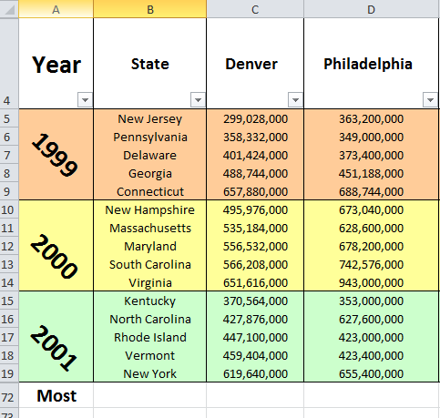
Which function would you use to find which state had the most quarters made by the Denver Mint?
=MIN(B4:B19)
=MAX(C5:C19)
=MOST(B5:B19)
=MAX(B5:B19)

Slide 22
Oops. Double check to make sure you have the correct range selected.
Go Back

Slide 23
“Excel”ent!!! Way to pay attention to detail.
The MAX function will tell you which number is greatest in a selected range.
This is the end of the training. Please press ESC and wait for teacher instructions.

