Slide 1
File Management
How to stay organized

Slide 2
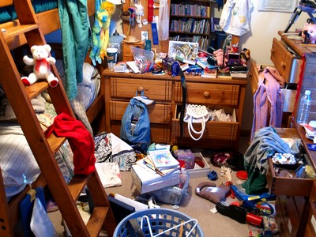
Cluttered Bedroom

Slide 3
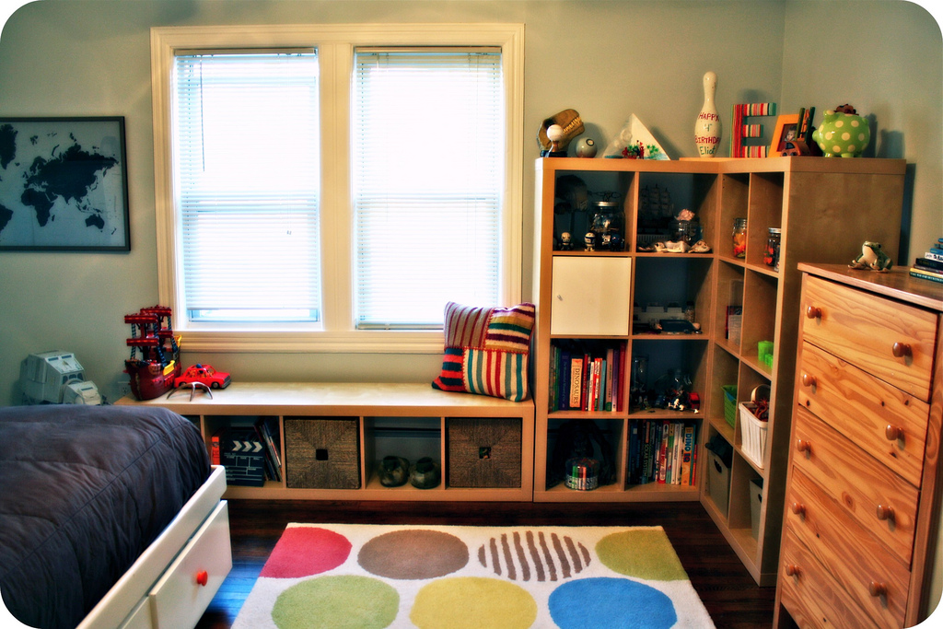
Organized Bedroom

Slide 4
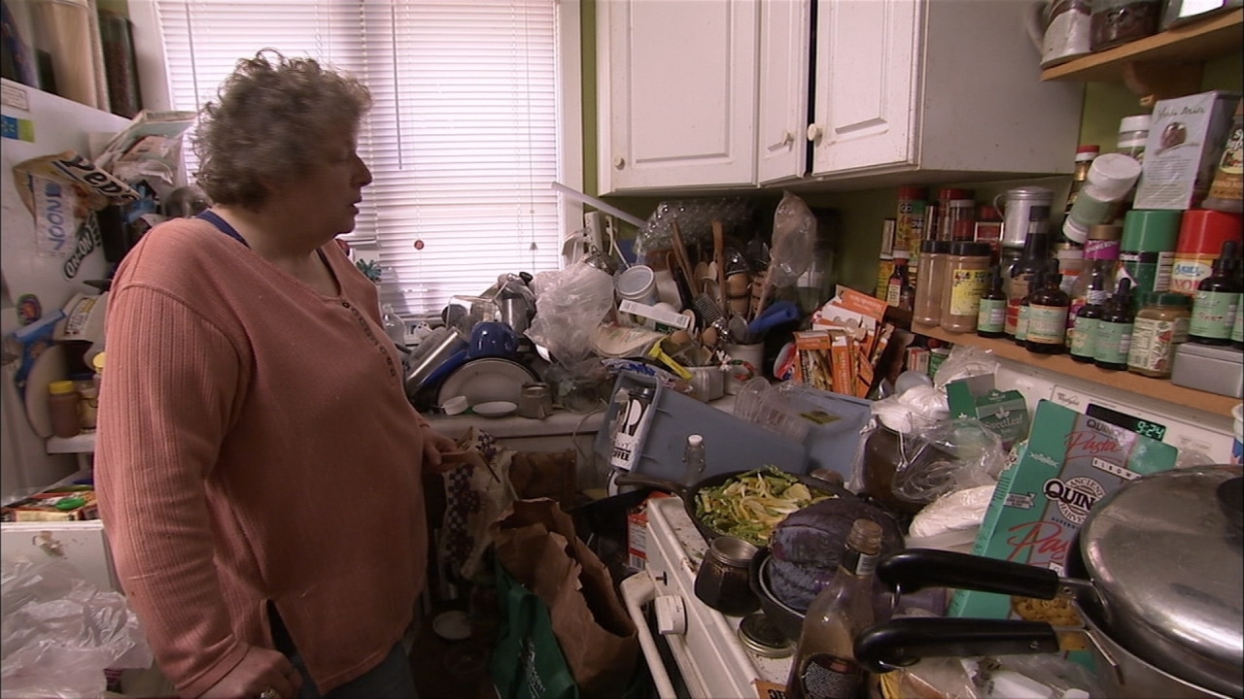
Where’s the Salt & Pepper?

Slide 5
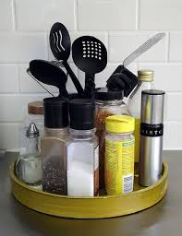
I found it. This is a lot easier.

Slide 6
What is the problem with these photos?
They’re all gross.
People are weird
Organization is so much better
They might be related to me

Slide 7
Good Job!
Just like in real life organizing your things, organizing your files is very important.
This is called File Management
Organizing your Files into Folders will help you stay organized and your assignments will not get lost.

Slide 8
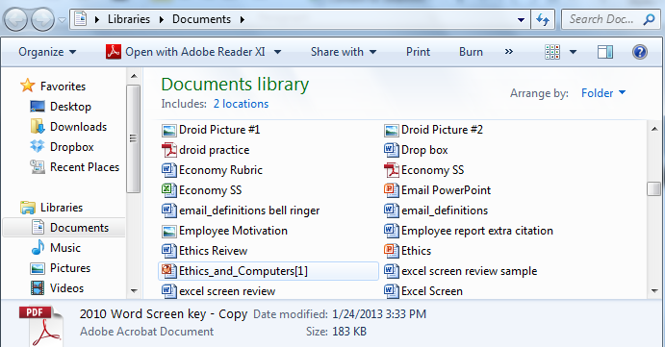
File: A collection of data or information that has a name, called the filename. Almost all information stored in a computer must be in a file. There are many different types of files: data files, text files , program files, directory files, and so on. Different types of files store different types of information. For example, program files store programs, whereas text files store text.
Files

Slide 9
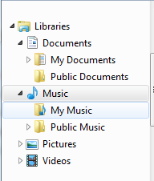
Folders: used to organized your files and other folders
Subfolder: folder inside another folder
Folder
Subfolder
Folder
Subfolder

Slide 10
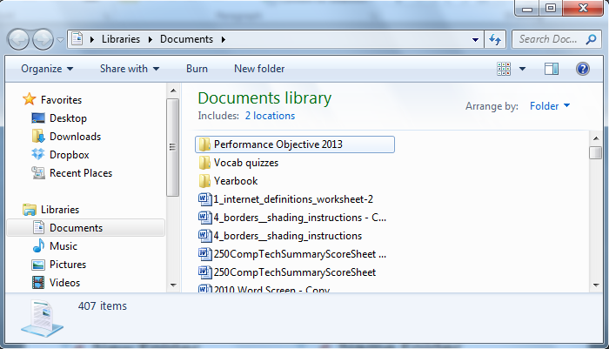
Create Folders
Go To Documents
Right Click
New Folder
Name Folder
Go to Documents
Click New Folder
Name Folder

Slide 11
Folder
Computer Technology
Word Processing
Spreadsheets
Presentations
Sub Folders
Other

Slide 12
How to delete File/Folder
Right click while file is selected
Delete
Select File
Click delete button on keyboard
OR
Select File
Click Organize
Click Delete

Slide 13
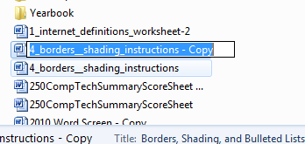
How to rename file/folder
Right click file/folder
Select Rename
Select File
Click again on file;
OR
Select File
Click Organize
Click Rename

Slide 14
File Extensions
the last three or four characters after the period that make up an entire file name. The file extension helps the operating system determine which program on your computer the file is associated with.
Examples
.doc/.docx – Microsoft Word
.ppt/.pptx – Microsoft PowerPoint
.xls/.xlsx – Microsoft Excel
.pdf – Portable Document File

Slide 15
File Corruption
Refers to a file that has been damaged in some way.

Slide 16
Multitasking
Working on 2 or more Programs at the same time.

Slide 17
Save/Save As
Save:
Save in existing location.
Save As:
Save in a new location or with a new name.

Slide 18
To Select Files
CTRL (Control)
Selects files that are not adjacent to each other
Chapter2.doc
Chapter3.doc
Chapter4.doc
Chapter5.doc
Shift
Selects files that are adjacent to each other
Chapter2.doc
Chapter3.doc
Chapter4.doc
Chapter5.doc

Slide 19
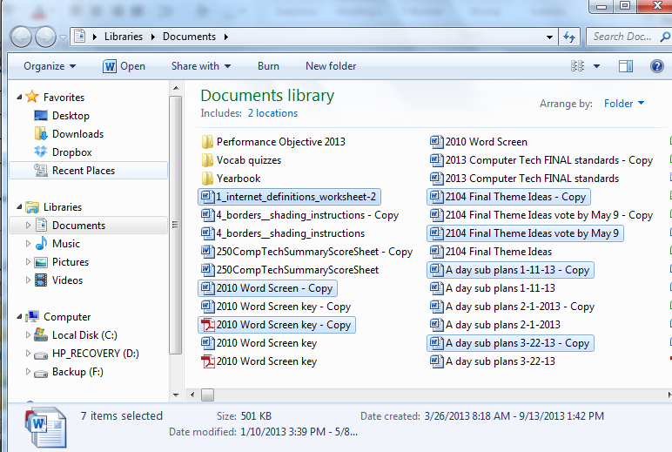
CTRL

Slide 20
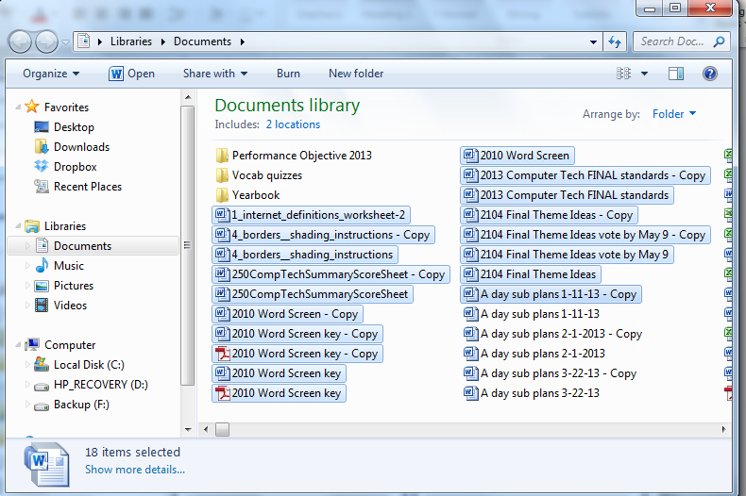
Shift

