Slide 1
Computer Technology: Types of Computers
Standard 1: Technology Operations and Concepts
Students will be introduced to and be able to demonstrate a sound understanding of computer technology: what types of technology exist, how types of technology function, what component parts work with specific technologies.

Slide 2
How Computers Work – Computers are designed to accept data a user enters, process data according to program instructions, and then output the processed data in a useful form – as information.
What is a Computer?
A device that accepts input, processes data, stores data, and produces output, all according to a series of stored instructions.

Slide 3
How Computers Work Basic Terminology
Input
Data that is entered into a computer or other device
Data
Raw, unorganized facts and figures that you put into a computer. Results of the computer storing, 1 & 0s, bits and bytes.
Information
The words, numbers, sounds, symbols, graphics, etc. produced by a computer. Data that has been processed to make it useful for a specific purpose. What you can get out of a computer.
Output
Information that results from the computer processing. For example, what is communicated, printed, shown on the monitor, or transmitted electronically.

Slide 4
How Computers Work Basic Terminology
Processing
The reading of 0’s and 1’s and determining (by software) what action to take. Manipulation of the data by the computer to create information.
Memory
Area of the computer that temporarily holds data waiting to be processed, stored, or given as output.
Storage
Area of the computer that holds data on a permanent basis when it is not immediately needed for processing.

Slide 5
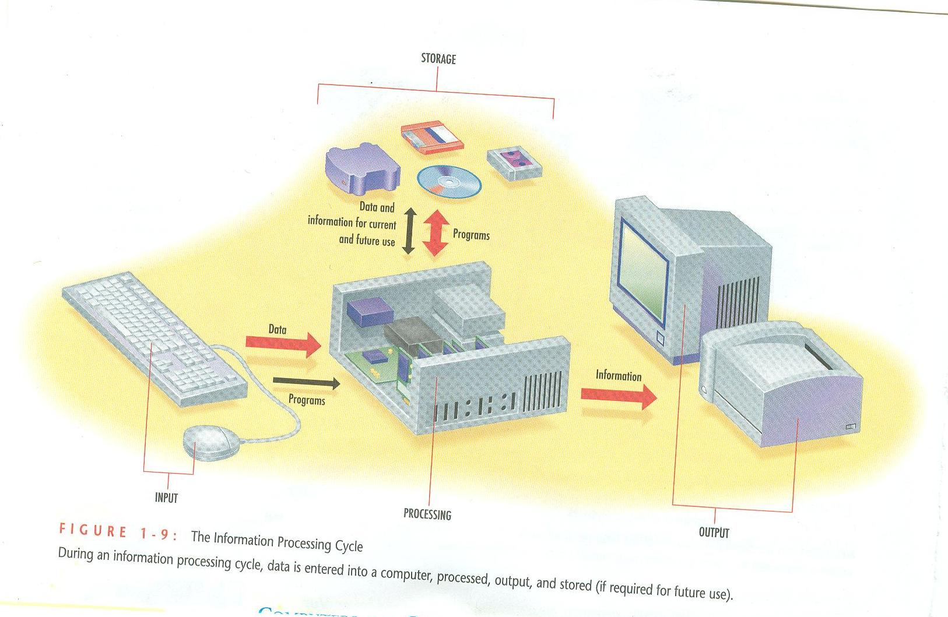
Information Processing Cycle – using a computer to convert data into useful information

Slide 6
Types of Computers

Slide 7
1. Personal Computer (PC)
Self-contained computer capable of input, processing, output, and storage.
Must have at least one input device, one storage device, one output device, a processor, and memory.
Three major groups of PCs are desktop computers, portable computers, and mobile devices/handheld computers.

Slide 8
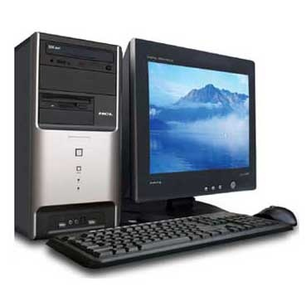
2. Desktop Computer
PC that fits on a desk and runs on power from an electrical wall outlet.
The CPU can be housed in either a vertical or a horizontal case.
Has separate components (keyboard, mouse, etc.) that are each plugged into the computer.
May be used in the home, home office, library, or corporate setting.

Slide 9
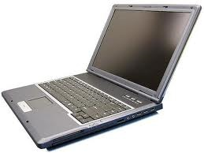
Portable Computer: 3. Laptop, Netbook
A personal computer that is small enough to be moved around easily.
Laptop Computer: A portable computer that is small enough to be placed on a lap or carried by its user from place to place.
It is also referred to as notebook
Netbook: Computer that is smaller and has less power than a full-size notebook. It’s main purpose being e-mail and Internet access.

Slide 10
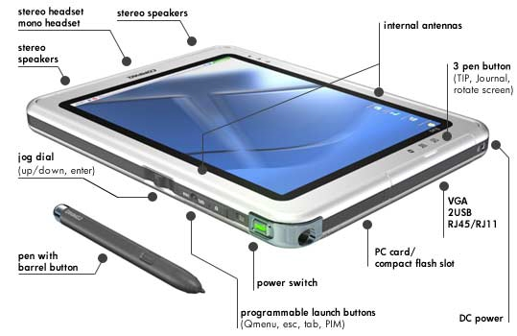
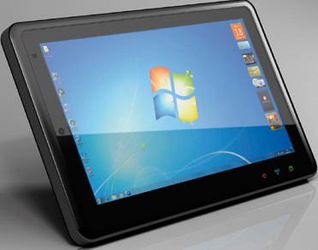
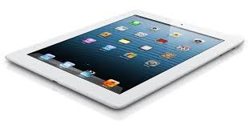
Portable Computers: 4. Tablets
A tablet is a one-piece mobile computer. They typically have a touchscreen with few physical buttons but an on-screen, virtual keyboard is commonly used.
Though generally self-contained, a tablet computer may be connected to a physical keyboard or other input device.
Examples:
Slates – Tablets without dedicated keyboards like the iPad and Android Tablets
Mini Tablet – Smaller and lighter than standard tablets. Generally 6 – 7 inches. Kindle Fire, Galaxy Tab
Phablet – Cross between a phone and a regular tablet. LG Optimus Vu, Samsung Galaxy Note, and Dell Streak
Dedicated keyboards – These tablets blur the line between slate tablets and laptops
Convertibles – a slate tablet top-half with a permanently attached keyboard bottom-half. (Panasonic Toughbook, Inspiron Duo)
Hybrids – Hybrid tablets have a standard tablet base with a detachable keyboard that resembles a laptop keyboard.
Booklets - Booklets are dual-touchscreen tablet computers

Slide 11
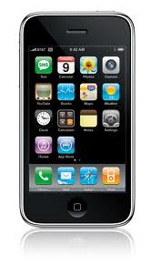
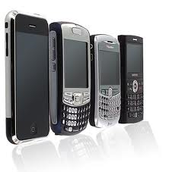
5. Mobile Devices/Handheld
Personal computer small enough to fit into a person’s hand, also called handheld, pocket PC or Palmtop.
Many can be synchronized with a personal computer as a backup.
Examples:
Mobile Internet device
Personal Digital Assistant (PDA)
IPod – MP3 Players
Smartphone / Tablet – Mobile Phone
Tablet Computer
Portable Media Player
Handheld Game Console
Calculator
Handheld game console
Portable media player
Digital still camera (DSC)
Digital video camera (DVC or digital camcorder)
Mobile phone
Pager
Personal navigation device (PND)

Slide 12
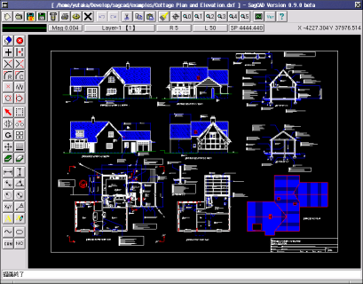
6. Workstations
High-performance single-user computer with advanced input, output and storage components that can be networked with other workstations.
Resemble desktop personal computers but provide users with more processing power and greater capabilities.
Used for complex applications that require considerable computing power and high-quality graphics resolution.
Examples are computer-aided design (CAD), computer-assisted manufacturing (CAM), desktop publishing, and software development.
Can also be an ordinary personal computer attached to a LAN (Local Area Network).

Slide 13
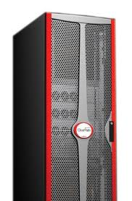
7. Mainframe Computers
Capable of accommodating hundreds of network users performing different computing tasks.
Government agencies, banks, universities and insurance companies use them to handle millions of transactions each day.
Usually the size of a large cabinet.

Slide 14
8. Supercomputers
Fastest, most powerful, and most expensive type of computer designed for multiple users.
Many are capable of performing trillions of calculations in a single second.
Typical uses
Weather forecasting
Comparing DNA sequences
Creating artificially intelligent robots
Performing financial analyses

Slide 15
9. Special Purpose Computers
Computers are, in fact, all around you. Microprocessor chips are found in many electronic devices (in your iPod, in your DVD player, in your microwave, in your car, and in your phone). These are special-purpose computers that run programs to control equipment and optimize its performance.
Examples:
Household appliances
Automobiles
Car keys
Tools
Test instruments
Toys
Light switches/dimmers
Electrical circuit breakers
Smoke alarms

Slide 16
10. Computers in your home
What type of computer(s) do you have at your home. If you don’t have any, answer none. (Don’t include special-purpose computers like tools, car keys, etc.)
Example – At my house, we have 1 desktops, 3 laptops, 2 iPods, 1 iPad, 3 smartphones, 2 Samsung Galaxy tablets, 1 Surface Pro 3, and 1 Wii. I think that is all.

Slide 17
A few more questions…
11. Do you have Internet access at home?
12. Do you have Wi-Fi access at home?
13. Do you have a printer at home?

Slide 18
Resource
Fuller, Floyd; Larson, Brian. Computers Understanding Technology. St. Paul: Paradigm Publishing, Inc. 2011.
Gordon, Jon; Lankisch, Karen; Muir, Nancy; Seguin, Denise; Verno, Anita. Our Digital World. St. Paul: Paradigm Publishing, Inc. 2011.

