Slide 1

Internet

Slide 2
3
2
1
4
Someone creates a website
They load it to a web server computer
We must have an Internet connection
We can see the websites on a browser

Slide 3

HTML – Hyper Text
Markup Language
The language a website is
created in.
To View Google’s HTML:
  Click on the GOOGLE image to the left.
  Right click when on the Google
home page.
  View Page Source
  To return to this PowerPoint
just close out of the browser.

Slide 4
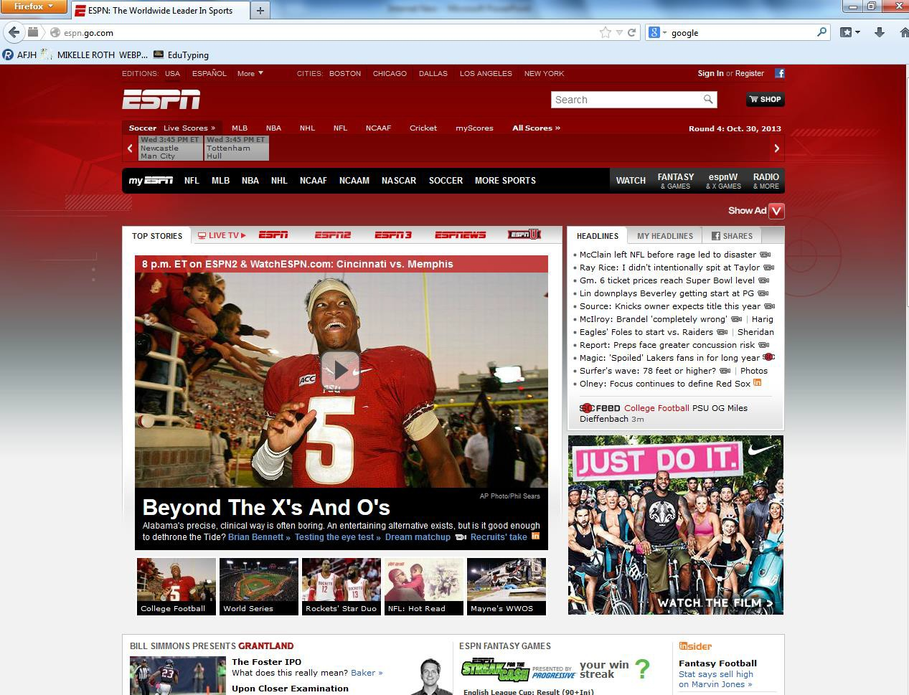
What you see…

Slide 5
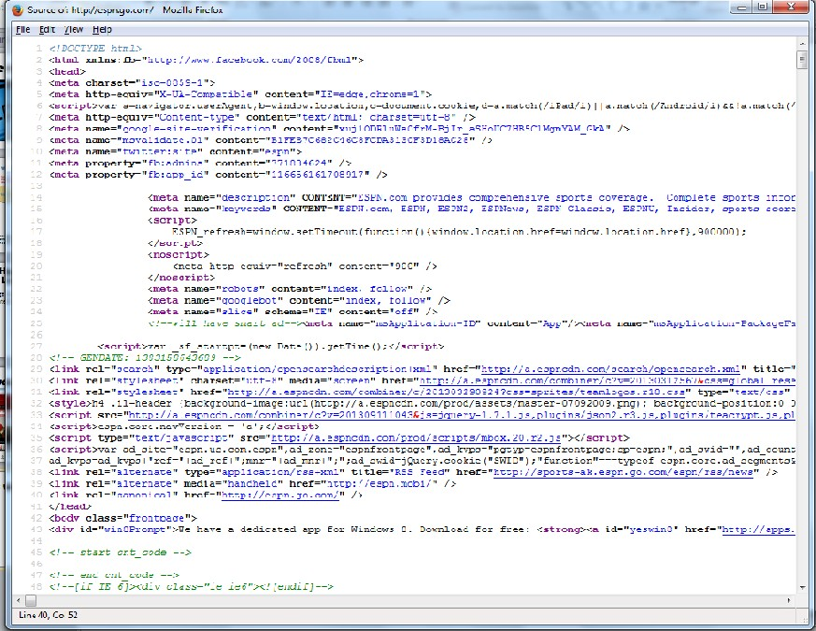
How it is written…

Slide 6
Important Info
Home Page: The main page, or table of contents for
the website
Wiki: Allows collaborative editing of its content by
all of its users
Blog: A personal website which individuals give
opinions and link to other websites
Podcasts: A multimedia (usually sound) digital file made available on the internet to download to a portable player (MP3, iPod, etc.)

Slide 7
Why you should be a
programmer…
Average Starting Salary = $72,000
Starting Salary in Rochester, MN = $114,000
Starting Salary in Santa Fe, NM = $109,000

Slide 8
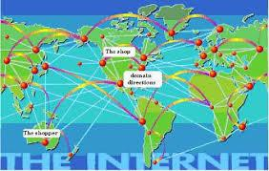
Definitions
WWW = World Wide Web
  A giant web of connections that link us together across the world.

Slide 9
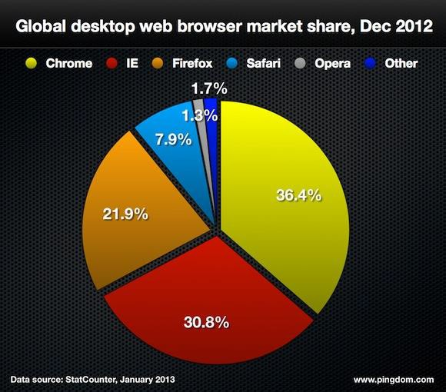
Browser
A Software program that allows you to view the Internet
  You have to have a browser to see the Internet.
Examples:
  Google Chrome
  Safari
  Firefox
  Internet Explorer

Slide 10


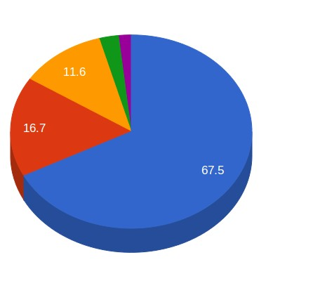



Search Engines
A website that allows you to search for information using keywords.
  It returns a list of links about the information you searched.
Examples:
  Google
  Bing
  Yahoo
  Ask

Slide 11

Domain Name
Tells you what type of website you are looking at.
  There are hundreds of thousands of different domains out there.
  Most countries have
their own domains

Slide 12
Domain Name
Continued…
Domain
.com = commercial website
.gov = government website
.edu = educational institute
.org = nonprofit organization
.net = network website
Example
www.target.com
www.whitehouse.gov www.byu.edu www.redcross.org www.comcast.net

Slide 13

Cookie
No NOT this!
This!
Small files on your computer that a website accesses to personalize a website
  Next time you log on to that site it may remember your name and other info about you.
  Be careful about what you do on a public computer

Slide 14
URL – Uniform Resource
Locator
Definition:
The address needed to access a website
URLs have the following format:
Protocol://hostname/other_information
Example:
http://www.facebook.com

Slide 15
Hypertext Link (aka:
Link)
Definition:
Picture of text when clicked will take you to a new location on a website
Example
  AFJH Website
  You can see that the words above are underlined, this
usually indicates it is a link.
  If you click it you will be taken to the AFJH website.

Slide 16





ISP
Definition:
Internet Service Provider
  A company you pay to hook up the Internet at home,
in schools, at a business in an office, etc.
Examples:

Slide 17
Types of Internet
Connections
Dial – up: Phone line; Used to take 30 minutes to
download a song, 20+ hours to download a movie
Broadband (High Speed): Popular Internet connection.
Usually through a cable that connects to a modem.
Wireless: 4g LTE, Wireless Broadband connect through
satellites and towers set up to receive signal.
WiFi: Allows computers and phones to connect to
internet wirelessly

Slide 18

The Cloud

Slide 19
What is it?
Back in the day, all of your data was stored on your hard
drive, discs, CD’s and other storage devices.
Now there is a better way. It is stored in a magical place
not on your computer called:
The Cloud

Slide 20
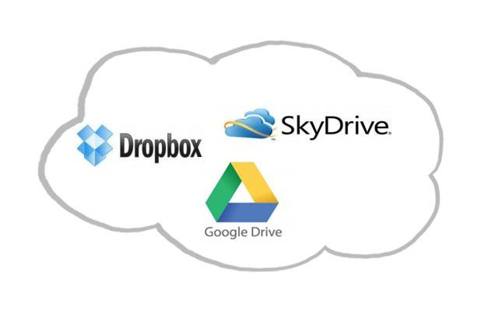
But, really. What is it?
It is an APPLICATION that is hosted or run on Internet
Servers.

Slide 21




Which one is best?
2GB Free Space; File Size Limit = Unlimited; All Platforms, Best for :
Seamless document streaming
15 GB Free Space; File Size Limit = 10 GB (Platforms: Windows, Mac iOS,
Adroid)
Best for: Storage Space and Web Apps
7 GB Free Space, File Size Limit = 2GB; (Platforms: Windows, Mac iOS,
Adroid, Windows Phone)
Best for Windows/MS Office Integration
Free Space: 5 GB; File Size Limit = 25MB Free/250MB Paid Platform: OS,
iOS, Windows
Best for: Heavy iTunes/Mac Users

Slide 22
Do I use it without even
knowing?
NetFlix
Hulu
Pandora
Spotify
Facebook Games
Uploading files in Mrs. Roth’s Class; Drop it to me;
Google Drive.

Slide 23
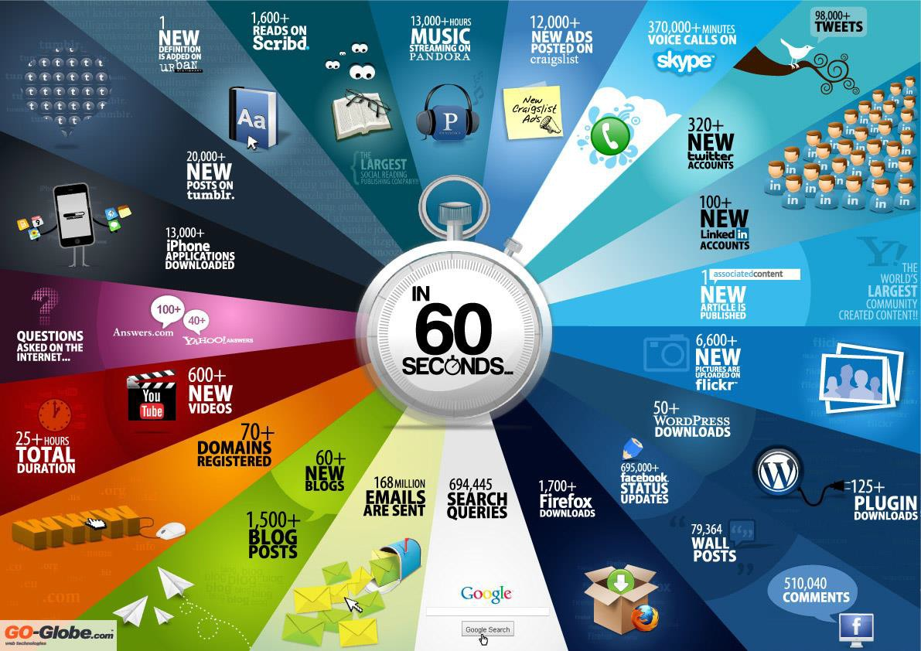
This is what happens on the
Internet every 60 seconds
The Internet is in EVERY aspect of our lives

