Slide 1
POWERPOINT REVIEW
Computer Technology – January 2015

Slide 2
After reading the definition, think of the answer. Then, click to reveal the answer and see if you are correct.
An application software program used to create an electronic slide show
Presentation
software like
Microsoft
PowerPoint

Slide 3
After reading the definition, think of the answer. Then, click to reveal the answer and see if you are correct.
Placement of text and objects on a slide
Layout

Slide 4
What menu is this picture showing?
Correct – click to go on
Layout Menu
Incorrect
Design Menu

Slide 5
Which slide layout would be best?
If I have a list of items and a picture, which slide layout would be best?
Correct – click to go on
Two Content
Oops – try again
Title Only
Oops – try again
Blank

Slide 6
Which slide layout would be best?
If I have a video for my slide, which slide layout would be best?
Oops – try again
Comparison
Correct – click to go on
Title and Content
Oops – try again
Two Content

Slide 7
After reading the definition, think of the answer. Then, click to reveal the answer and see if you are correct.
Name 3 types of objects that you can INSERT
Shapes
Clipart
Pictures
Word Art
Chart

Slide 8
After reading the definition, think of the answer. Then, click to reveal the answer and see if you are correct.
If you change the inside color of an object, you are changing the
Fill

Slide 9
After reading the definition, think of the answer. Then, click to reveal the answer and see if you are correct.
If you change the border of an object, you are changing the
Outline

Slide 10
After reading the definition, think of the answer. Then, click to reveal the answer and see if you are correct.
When you use the reverse circle to turn an object you are doing what with it?
Rotating

Slide 11
After reading the definition, think of the answer. Then, click to reveal the answer and see if you are correct.
What is the shortcut key to play a slide show?
F5

Slide 12
After reading the definition, think of the answer. Then, click to reveal the answer and see if you are correct.
What is the shortcut key to play a slide show from the currently selected slide?
SHIFT + F5

Slide 13
After reading the definition, think of the answer. Then, click to reveal the answer and see if you are correct.
What key can you press to exit a slide show at any time?
ESC (Escape)

Slide 14
Is this diagram showing Normal View or Slide Sorter View?
Normal View

Slide 15
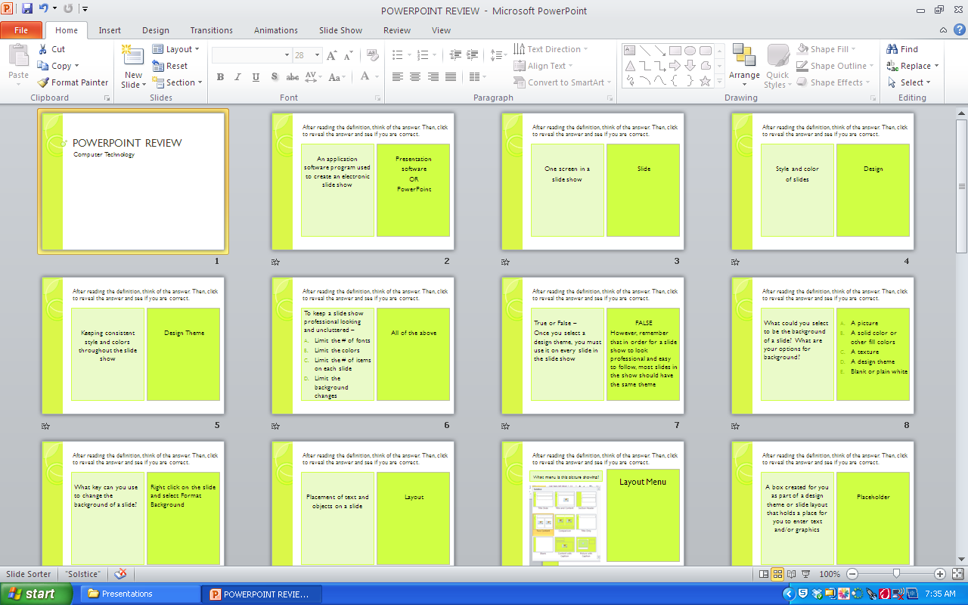
Is this diagram showing Normal View or Slide Sorter View?
Slide Sorter View

Slide 16
After reading the definition, think of the answer. Then, click to reveal the answer and see if you are correct.
You may move a slide when you are in which views?
Normal
Slide Sorter
Notes Pages
Slide Show
A and B
Normal and
Slide Sorter

Slide 17
After reading the definition, think of the answer. Then, click to reveal the answer and see if you are correct.
A small, visual representation of a slide or picture is called a
Thumbnail

Slide 18
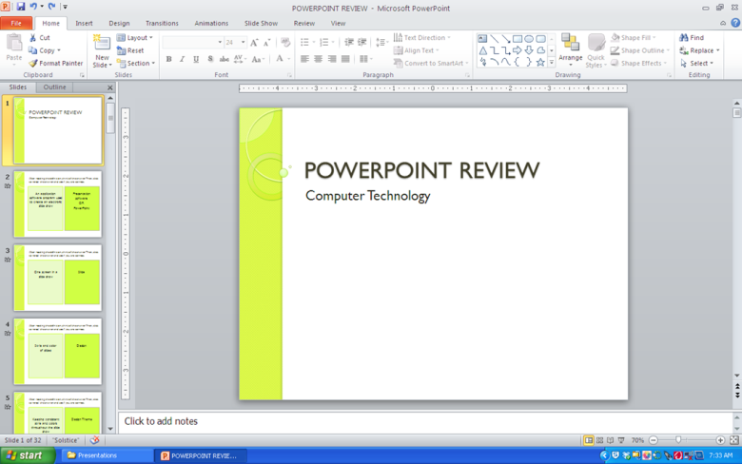
Which view(s) shows thumbnails?
Normal View
Slide Sorter View
(Thumbnails)
Normal and Slide Sorter Views
Slide Show View

Slide 19
Which view(s) shows ONLY thumbnails?
Normal View
Slide Sorter View
(Thumbnails)
Slide Sorter View
Slide Show View

Slide 20
After reading the definition, think of the answer. Then, click to reveal the answer and see if you are correct.
What does it mean to duplicate a slide?
Copy a slide

Slide 21
After reading the definition, think of the answer. Then, click to reveal the answer and see if you are correct.
What feature are you using when you decide how a slide will enter the screen?
Transition

Slide 22
After reading the definition, think of the answer. Then, click to reveal the answer and see if you are correct.
What choices do you have to advance a slide?
On mouse click
OR
After so many seconds

Slide 23
After reading the definition, think of the answer. Then, click to reveal the answer and see if you are correct.
What does it mean to Insert Audio?
Insert sound

Slide 24
After reading the definition, think of the answer. Then, click to reveal the answer and see if you are correct.
Adding an entrance, emphasis, or exit effect to text or objects
Animation

Slide 25
After reading the definition, think of the answer. Then, click to reveal the answer and see if you are correct.
Which feature controls the order of things entering a slide?
Transition
Action
Animation
C - Animation

Slide 26
According to this diagram, what will print?
All slides – one per page
Slides 1, 3, and 4
Handouts – 6 per page
Notes Pages

Slide 27
According to this diagram, what will print?
All slides – one per page
Slides 1, 3, and 4
Handouts – 6 per page
Notes Pages

Slide 28
THE END
Click here to start again

