Slide 1
SORTING RECORDS IN
EXCEL
Computer Technology

Slide 2
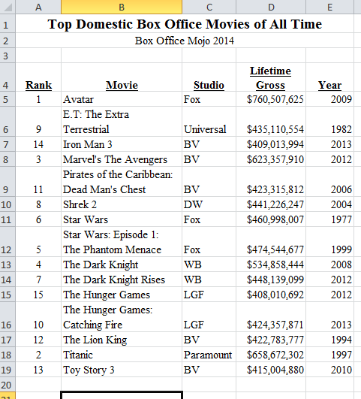
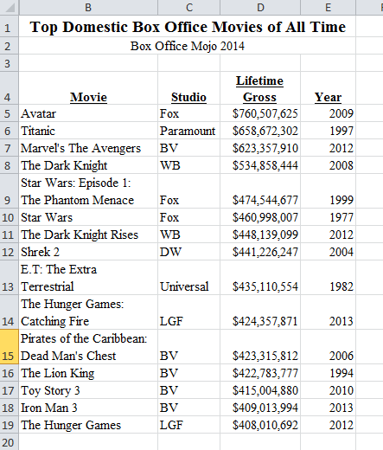
Sorting
Spreadsheet Software allows you to sort records in a specific order – alphabetical, numerical, etc.
Example: Spreadsheet below is sorted in Alphabetical order by Column A; Column A controlled the sort.
Example: Spreadsheet below is sorted in Reverse Numerical order by Column D; Column D controlled the sort.

Slide 3
Sorting Records
Open Sorting Records Practice (from my website in
Files for Assignments Folder)
Save as Sorting Records Practice in your Spreadsheets
Folder.
Create a footer with your name, Sorting Records, and class period.

Slide 4
Sorting Terminology
Click on Sheet named Terms and type the
definition for each term listed.
Records – Each row of data in a spreadsheet (all rows below the column headings).
Sort Ascending – sort in alphabetical order starting
with A or in numerical order starting with 1.
Sort Descending – sort in reverse alphabetical order (Z to A) or in reverse numerical order (starting with highest number).

Slide 5
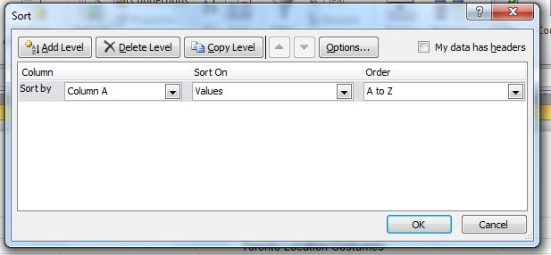
Sorting Records (cont)
Click back to Sheet 1.
Select (Highlight) A5:L19 (do NOT include Total when you are sorting; it should remain at the bottom).
Click Data and then Sort
The Sort Dialog Box will appear

Slide 6
Sorting Records (cont)
Sort by: select Column B.
Sort on: leave values
Order: select A to Z (this is sorting in alphabetical order.)
Click Ok.
Your spreadsheet should now be sorted in
alphabetical order by Column B.
Save As Sorting Records Practice Alpha.

Slide 7
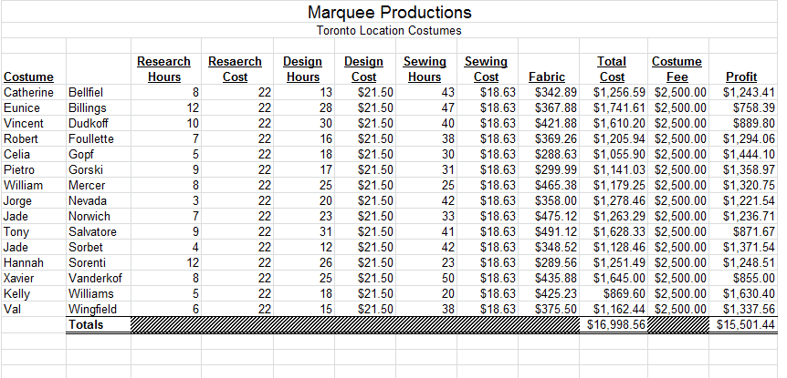
Sorting Records Practice Alpha
Example: This is what yours should look like.

Slide 8
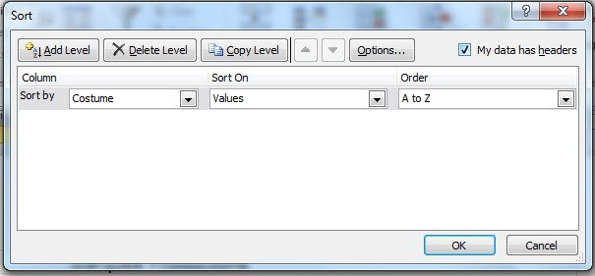
Sort Records Again
Select (Highlight) A4:L19. This time we are including
the Column Headings.
Click Data and then Sort
The Sort Dialog Box will appear.
In the top right corner click box next to my data has
headers.

Slide 9
Sort Records Again (cont)
After clicking my data has headers the selected text should be adjusted and Sort by should list the column headings instead of the Letter. Example: Costume instead of Column A.
Sort by: Profit (Column L)
Sort on: leave as values
Order: Largest to Smallest (descending)
Click ok.
Your spreadsheet should now be sorted in descending numerical order by Profit.
Save as Sorting Records Profit in your Spreadsheets folder.

Slide 10
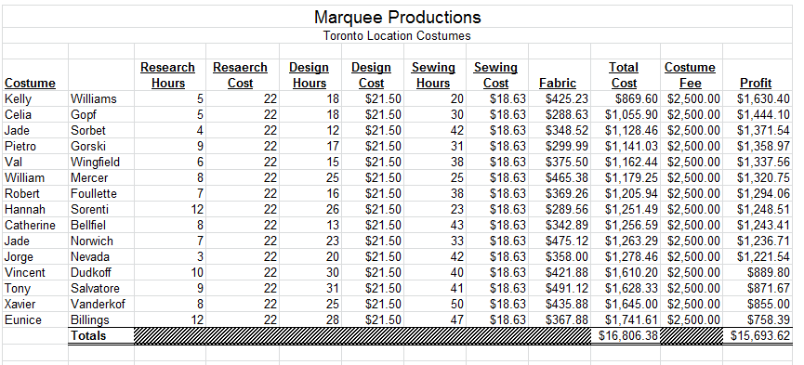
Sorting Records Profit
Example: This is what yours should look like.

Slide 11
3 Files with similar information
You should have 3 separate files for the work you
just did.
Sorting Records Practice (original, unsorted)
Sorting Records Alpha (Records sorted in
alphabetical order by Column B.
Sorting Records Profit (Records sorted in reverse numerical order by Profit).
The assignments you do today will all have 3 separate files as well. Make sure to follow directions carefully.

Slide 12
A few reminders
Ascending – (A-Z) or (smallest to largest)
Descending – (Z-A) or (largest to smallest)
Records – each row of data under the column headings.
Be sure to select (highlight) all cells of all records before you sort, otherwise you might jumble up the records and they will no longer be valid.

