Slide 1
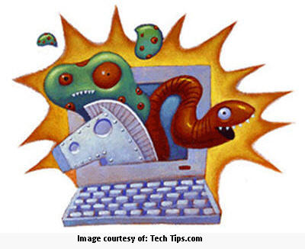
Computer Viruses

Slide 2
Definitions
Virus
A small piece of software that attaches itself to a program on the computer. It can cause serious damage to your computer.
Worm
A small piece of software that uses computer networks and holes in the network to replicate itself.
Your computer gets terribly sick! ☹

Slide 3
Email Virus
A virus sent through an email.
Sometimes it goes off by simply opening the email
Other ones go off by opening an attachment in the email.

Slide 4
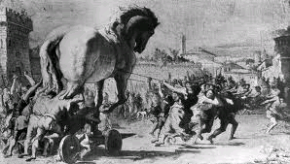
Trojan Horse
A computer program that claims to do one thing (it may claim to be a game) but instead does damage when you run it. It’s disguised as something else.

Slide 5
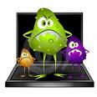
Boot Sector Virus:
A virus that infects the start-up files.
Time Bomb:
Computer virus that does not cause damage until a certain date or until the system has been booted a certain number of times.
Logic Bomb:
Computer virus that is triggered by the appearance or disappearance of specified data.

Slide 6
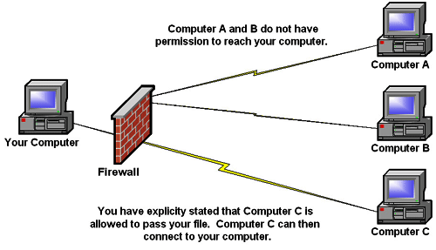
3 Things to Protect your Computer:
Anti Virus software
Firewall
3. Be very careful what you download to your computer and what you open in your email.

