Slide 1
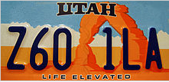
What Drives Utah’s Economy?
Economy definition: production & consumption of goods and services; management of available resources.

Slide 2
Tourism
“If tourism were a stock, if people could invest in Utah tourism, people would be putting their money down.”
"Utah is no longer a secret. “Utah is a ‘bucket list’ destination for tourists around the world.“
Deseret News

Slide 3
National Park Visits – 6.3 Million
Spending by tourists in Utah - $7.4 Billion
129,000 people employed by tourism industry
Utah ski visits – 4.2 Million
Total state & local taxes generated by traveler spending was $960.6 Million
State Government - $571 Million
Local Government - $389 Million
http://utahtourism.org/wp-content/uploads/2010/01/Tourism-Works-state-of-indu-10-13.pdf

Slide 4
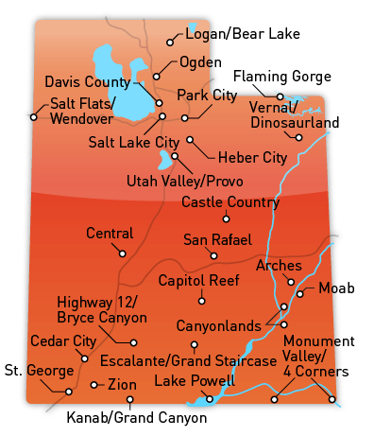
Utah’s Best Destinations
Arches National Park
Zions National Park
Bryce Canyon National Park
Canyonlands National Park
Capitol Reef National Park
Castle Country
Cedar City
Davis – Antelope Island
Flaming Gorge
Grand Staircase Escalante
Heber
Kanab (Grand Canyon)
Lake Powell
Logan – Bear Lake
Moab
Monument Valley – Four Corners
Ogden
Park City
Salt Lake City
San Rafael County
Utah Valley
Vernal – Dinosaurland
Wendover

Slide 5
Utah’s Top 10 Attractions
1. Bryce Canyon
2. Arches National Park
3. Zion National Park
4. Canyonlands National Park
5. Grand Staircase Escalante
6. Park City
7. Temple Square
8. Dinosaur National Monument
9. Capitol Reef
10. Lake Powell
http://www.attractionsofamerica.com/attractions/utah.php#.VIfd4THF-So

Slide 6
Other Attractions
Utah Shakespearean Festival
Hogle Zoo
Ballet West
Sundance Film Festival
Heber Valley Historic Railroad
Utah Olympic Park
Bonneville Salt Flats
Mt. Timpanogos Cave
Utah Olympic Park
Goblin Valley
Thanksgiving Point
Monument Valley
Goblin Valley

Slide 7
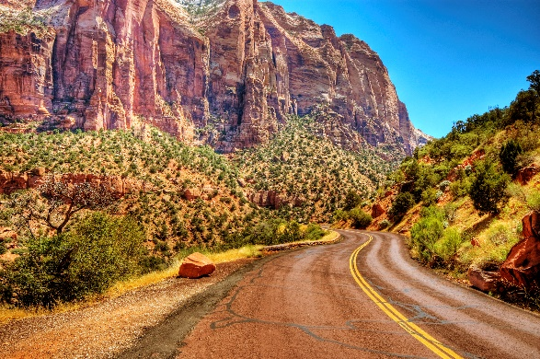
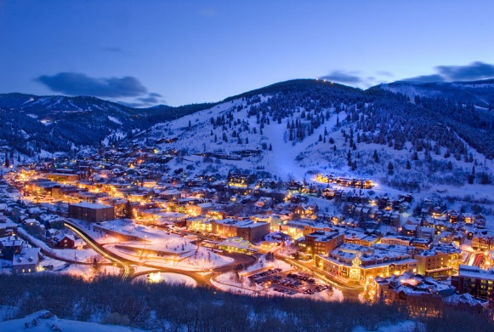
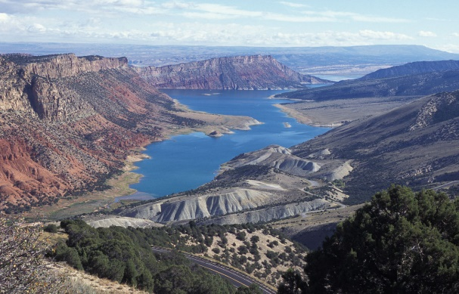
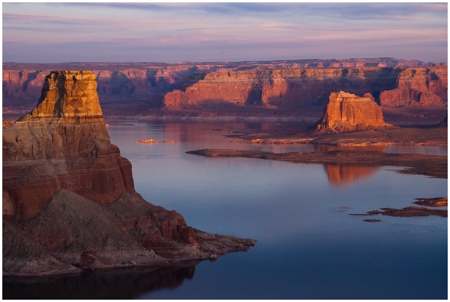
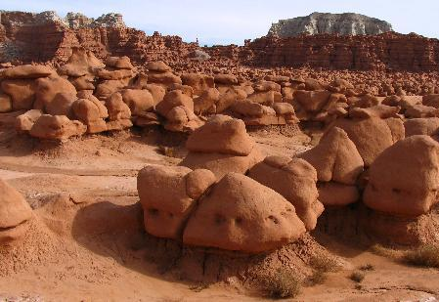
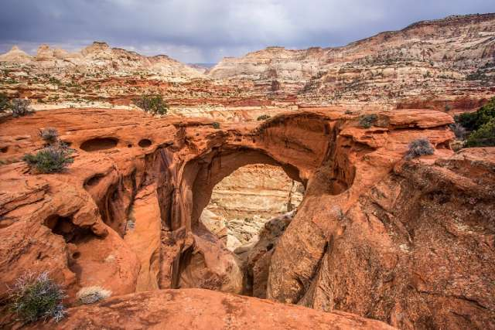
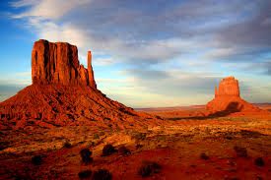
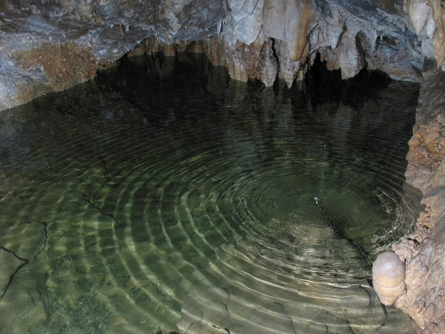
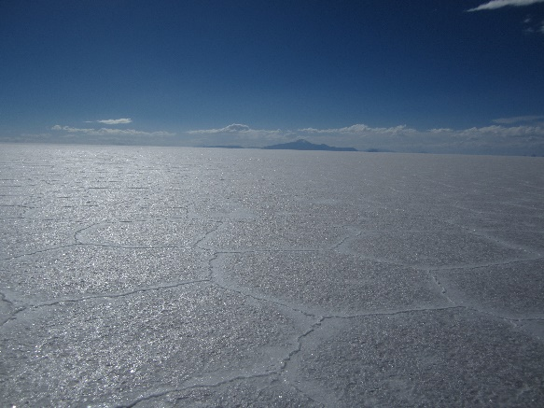
Can You Name Where This Is?
Zions
Park
City
Flaming
Gorge
Lake
Powell
Goblin
Valley
Capitol
Reef
Mt.
Timpanogos
Bonneville
Salt Flats
Monument
Valley

Slide 8
Tourism In Utah Films
The Mighty 5

Slide 9
Careers that go with the top 10 attractions
Food Service Manager
Hotel, Motel, and Resort Desk Clerks
Maids & Housekeeping Cleaners
Ushers, Lobby Attendants, Ticket Takers
Athletes and Sports Competitors
Gaming Manager
Gaming Cage Workers
Motion Picture Projectionists
Recreation Workers
Food Preparation Workers
Fast Food Cooks
Hosts and Hostesses
Short Order Cooks
Waiters and Waitresses
Tour Guides
Reservation Agents
Interpreters and Translators
Bartenders
Set & Exhibit Designers
Bakers
Janitors
Animal Trainers

Slide 10
TOURISM IN UTAH
Tourism is a major industry in Utah, and is well known for its year-round outdoor recreational activities.
Five National Parks - Arches, Bryce Canyon, Canyonlands, Capitol Reef, & Zion
Utah has the third most national parks of any state after Alaska and California.
Seven national monuments,
Two national recreation areas
6 national forests
Numerous state parks and monuments.

Slide 11
2002 Winter Olympics
Held for sixteen days of February, 2002
Profits: $100 Million
Sales: $4.8 Billion
Jobs: 35,000
Increase in skier visits since 2002: 42%
Expenditures from skiers and snowboarders:
2002-2003 - $704 Million
2010-2011 - $1.2 Billion
Hotel rooms – 25% increase from 2002 – 2009
National governing bodies for speedskating, bobsled, and skeleton have moved to Salt Lake.

Slide 12
Utah is Well Known For…
Park City is home to the US Ski Team.
Utah's ski resorts are primarily located in northern Utah.
In 2008, Deer Valley, in Park City, was ranked the top ski resort in North America.
Northern Utah's ski resorts are well liked among tourists for their convenience and proximity to a large city and International Airport, as well as the close proximity to other ski resorts, allowing skiers the ability to ski at multiple locations in one day.

Slide 13
Fun Facts about Utah
45th state admitted to the Union on January 4, 1896
13th largest state
33rd most populated
2nd fastest-growing state in the US
Overall best state to live in – Gallup survey 2012
#1 Best State for Business – Forbes 2014

Slide 14
Fun Facts about Utah
Capital: Salt Lake City
Governor: Gary Herbert
Colleges & Universities: University of Utah, Utah State University, Brigham Young University, Weber State University, Utah Valley University, Salt Lake Community College, Southern Utah University, Dixie State University, Snow College, etc.

Slide 15
Fun Facts about Utah
Senators: Orrin Hatch, Mike Lee

Slide 16
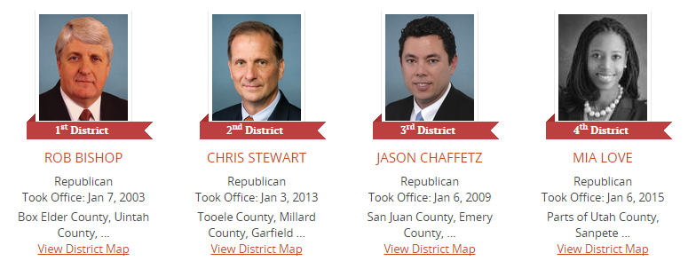
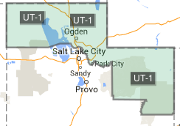
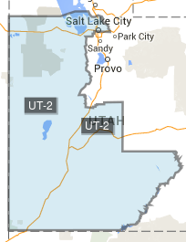
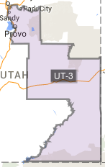
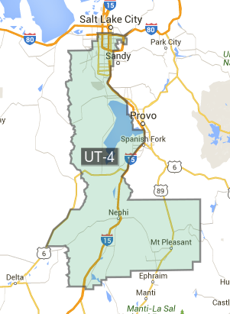
Fun Facts about Utah
Representatives: Rob Bishop, Chris Stewart, Jason Chaffetz, Mia Love

Slide 17
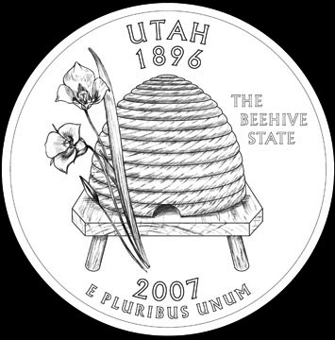
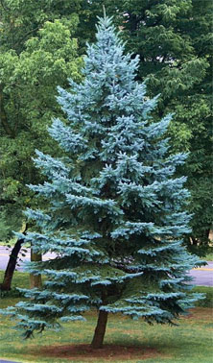
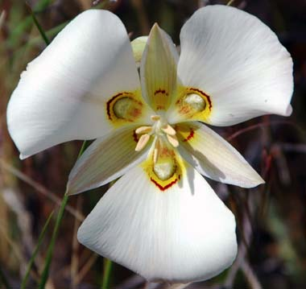
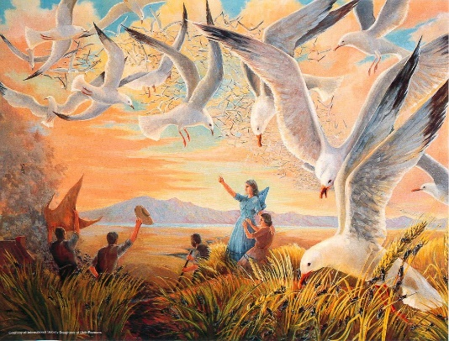
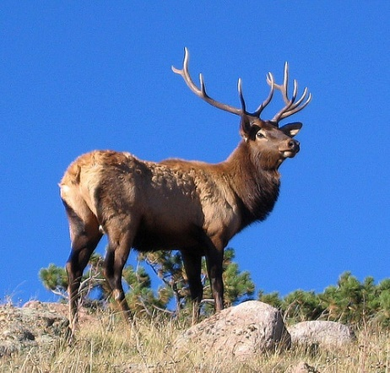
Fun Facts about Utah
Origin of name: Ute Indians
Nickname: Beehive State
Motto: Industry
Emblem: Beehive
Slogan: Life Elevated
Bird: California Seagull
Animal: Rocky Mountain Elk
Fish: Bonneville Cutthroat Trout
Flower: Sego Lilyl
Insect: Honeybee
Tree: Blue Spruce
Fruit: Cherry

Slide 18
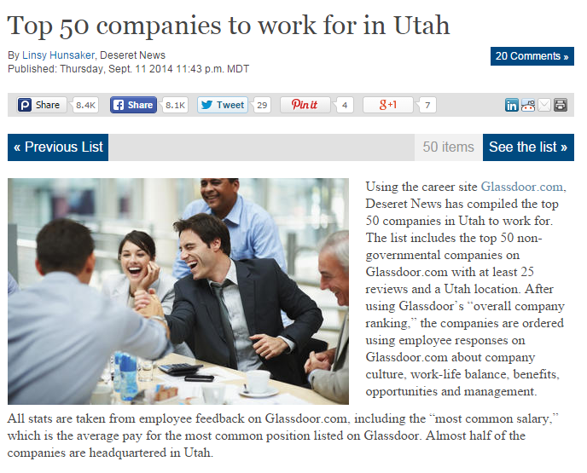
Top 50 Companies to work for in Utah
Click on the picture for the link

